Slide 1
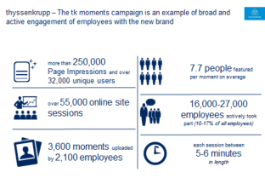
Two-year branding transformation journey aimed at repositioning client – from a steel player to a diversified industrial
Basic Materials (GEM) | Western Europe
BAS010
Situation
What we did
Impact
Branding project aimed at repositioning
Wide-scale research involving >6,000 stakeholders (incl. customers, (potential) employees, investors) and using McKinsey’s proven BrandMatics® approach
A few weeks after launch…
Awareness – 1 out of 4 have already heard about the new brand (4 out of 5 within 3 months)
Association of new logo most frequently to attributes such as “modern” & “innovative”
Almost 30,000 employees (18% of all employees) participated and activated through digital campaign
Today:
Perceived as steel player
Engineering rather than customer focus
Steel- and German-centric
Little innovation power
Broad stake-holder management
Brand architecture redesign. Simplified and optimized the brand portfolio and architecture across all BAs – from a total of ~ 180 brands to 20-30 brands
Objective:
Position as diversified industrial player
No big bang implementation – Implementation by using a credible approach (EUR ~10 mn vs. ~100 mn implementation costs)
Diversified industrial conglomerate
Strong customer focus
Attractive international player, shaping the future
Instrumental for opening up other transformational situations
SOURCE: Team analysis

